Slide 1
Design and Implementation of Anti-collision Algorithms for Dense RFID Systems
A Doctoral Thesis
by
Hazem Elsaid Ibrahim
MSc of Electrical Engineering
Notes:
Good afternoon everyone.
Today I will present my doctoral thesis under the title of “Title"

Slide 2

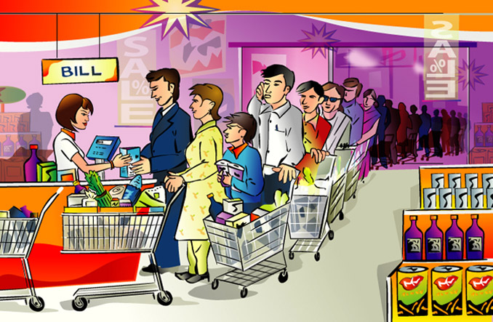

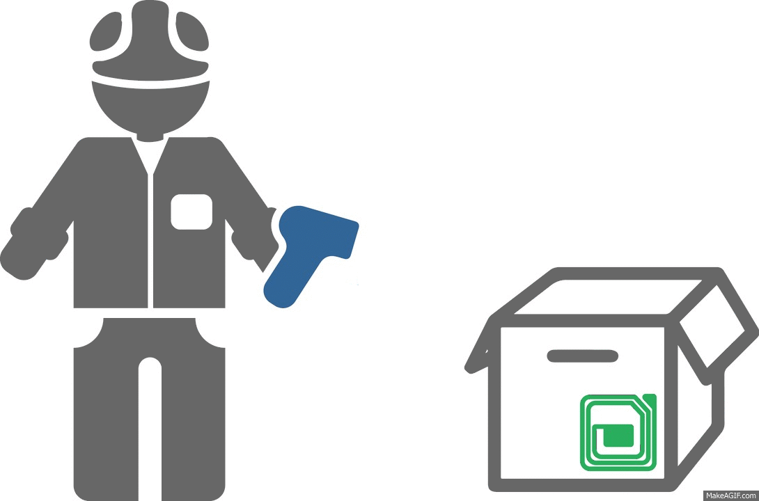

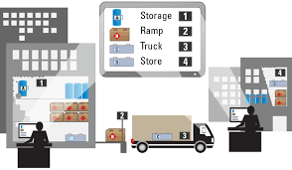

Motivation
Notes:
Most of us spend a lot of time waiting to pay for his GOODS. This problem demotivates us from doing shopping. Nevertheless, it encourages the researches to find a faster identification system.
On a large scale, we can imagine how tracking the status and the location of the shipped items is extremely valuable information for the logistics companies.
Moreover, in big factories, having a good tracking system is very important to avoid expensive delays or missing deadlines.
all these applications use either Barcode or RFID technology.

Slide 3
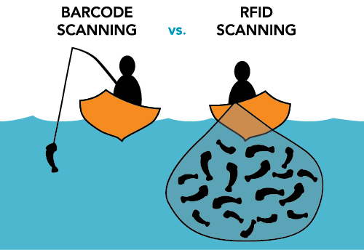

Differences Between RFID and Barcode
Limited to LOS scanning
Manual intervention
Not limited to LOS scanning
Fully automated process
Read Only
Significantly faster
Read/write
Limited speed
Notes:
Let's now have a look at the differences between the RFID and Barcode.
Therefore, these advantages encouraged the research groups to pay more attention to the RFID technology especially in dense applications.

Slide 4




Outline
01
RFID Reading Process
02
MAC-Layer Optimization Proposals
Tags Population Estimation
Frame Length Optimization
03
Improvements of the EPCglobal C1 G2 Standard
04
Conclusion
Notes:
The outline of this presentation includes:
A brief introduction to the conventional RFID reading process.
Afterwards, the proposed MAC layer optimization will be discussed in details, for both Tag estimation and in Frame length optimization.
Then, the proposed improvements of the EPCglobal C1 G2 will be discussed in details.
Finally, conclusion for the work will be presented

Slide 5
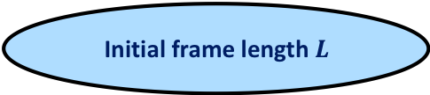

RFID Reading Process Frame Slotted ALOHA (FSA)^{[1, 2]}
Initial frame length $L$
Tag
Reader
$$L$$
[1] F. Schoute 1983.
[2] H. Vogt 2002.
Notes:
This work focuses on SYSTEMS, that have single RFID reader and dense RFID objects (tags).
The main target is to identify all the tags in the reading area in the minimum possible time.
Conventional reading process uses FSA.
FSA starts with initial frame length L
The reader broadcast the frame length to all the tags in the reading area.
Then every tag chooses random slot to reply

Slide 6
RFID Reading Process Frame Slotted ALOHA (FSA)^{[1, 2]}
Initial frame length $L$
Observe slots
(Successful)
Tag
Reader
S
$$L$$
[1] F. Schoute 1983.
[2] H. Vogt 2002.
Notes:
Thus, the reader receives a successful slot, when it only receives a single tag reply

Slide 7
RFID Reading Process Frame Slotted ALOHA (FSA)^{[1, 2]}
Initial frame length $L$
Observe slots
(Successful, Empty)
Tag
Reader
S
E
$$L$$
[1] F. Schoute 1983.
[2] H. Vogt 2002.
Notes:
If no tag choose this slot, the reader will receive an empty slot

Slide 8
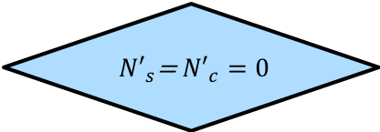
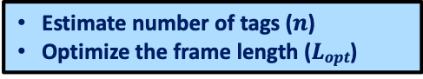
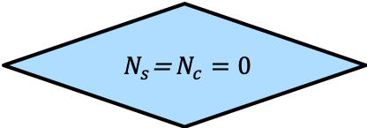
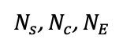
RFID Reading Process Frame Slotted ALOHA (FSA)^{[1, 2]}
Initial frame length $L$
Observe slots
(Successful, Empty, Collided)
$N_{s}\text{, }N_{c}$, $N_{E}$
$N_{s}\text{=} N_{c}=0$
yes
End
No
Tag
Estimate number of tags ($n$)
Optimize the frame length ($Lopt$)
Reader
S
E
C
$$L$$
[1] F. Schoute 1983.
[2] H. Vogt 2002.
Notes:
for more than single tag reply, it will be a collided slot.
Afterwards, the reader counts the number of collided successful and collided slots.
if they are zero, the reader will end the process.
if not, the reader will continue doing the following two steps:
Estimate the remaining number of tags
calculate the optimum frame length for the upcoming reading cycle.
This step is the most critical step in optimizing FSA

Slide 9


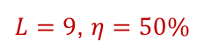

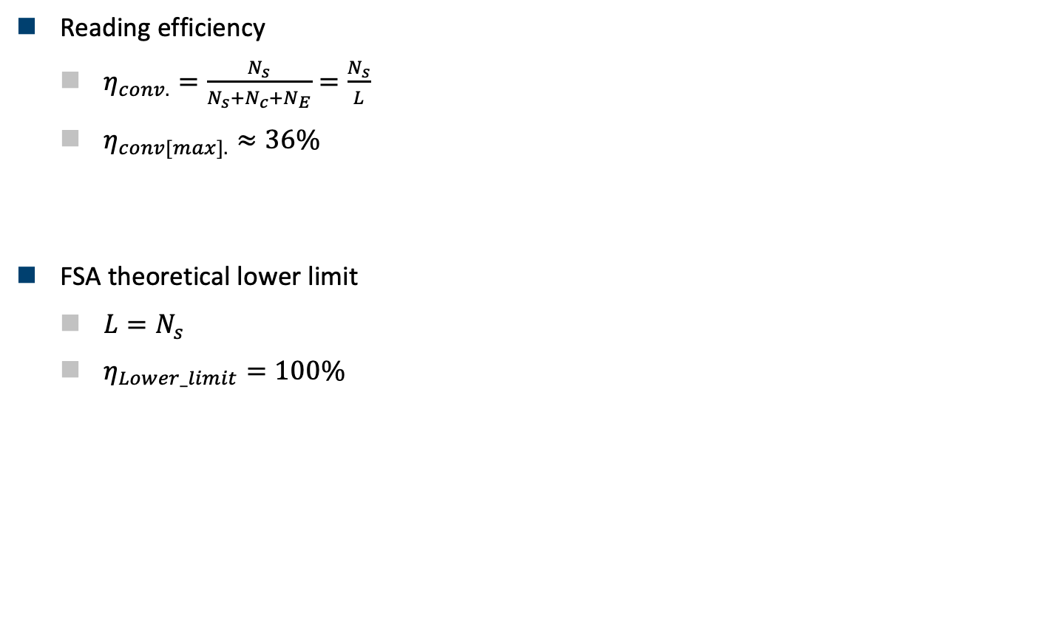


RFID Reading Process Frame Slotted ALOHA (FSA)^{[1, 2]}
Reading efficiency
$η_{conv.}=\frac{N_{s}}{N_{s}+N_{c}+N_{E}}=\frac{N_{s}}{L}$
$η_{conv[max].}≈36\%$
FSA theoretical lower limit
$L=N_{s}$
$η_{Lower_limit}=100\%$
S
C
E
C
C
S
$$L$$
How Can we approach the
Theoretical Lower limit
of FSA?
$L=9$, $η=50\%$
S
S
S
S
S
S
$$L$$
Notes:
The FSA reading efficiency is the number of NS/L
the reading efficiency is limited by the empty and collided slots.
According to the state of the art, the max reading efficiency of the conventional FSA is 36%
When the reading efficiency is 100%, this is called the FSA theoretical lower limit.
This is achieved when all collided and empty slots are converted to successful slots
Now the question is:…

Slide 10
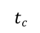
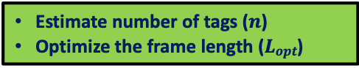

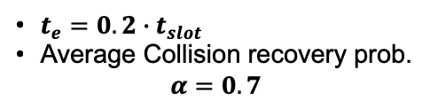
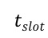
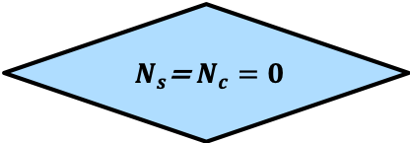
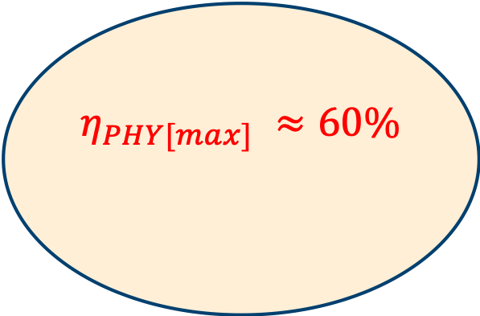
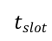
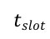
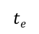
RFID Reading Process PHY-Layer Capabilities^{[3, 4]}
Initial frame length $L$
Time Aware ^{[3]}
S
C
E
C
C
S
$$tslot$$
$$tslot$$
$$tslot$$
Observe slots
(Successful, Empty, Collided)
S
C
E
C
C
S
$$η_{PHY[max]} ≈60\%$$
$N_{s}\text{, }N_{c}$, $N_{E}$
$$tS$$
$$tc$$
$$te$$
$N_{s}\text{=} N_{c}=0$
yes
End
Collision Recovery ^{[4]}
No
$t_{e}=0.2∙t_{slot}$
Average Collision recovery prob. $α=0.7$
PHY-Layer
S
C
E
C
C
S
Time Aware
Collision Recovery
Estimate number of tags ($n$)
Optimize the frame length ($Lopt$)
S
S
E
C
S
S
[3] J. Alcaraz, et al 2013.
[4] D. Donno, et al 2012.
Notes:
Modern RFID readers, have advanced physical layer capabilities:
The first one is the time aware capability, where, The Reader can identify the type of a slot. Then, terminates the slot as soon as it recognizes that the slot is an empty or collided slot.
therefore, the duration of the empty slot is smaller than the duration of the collided and the successful slots.
The second one is the collision recovery capability, where The reader has the capability of converting part of the collided slots into successful slots.
According to the state of the art, FSA efficiency reaches 60% if the slot duration of the empty slot is 0.2 of the normal slot duration and with collision recovery probability 0.7.

Slide 11

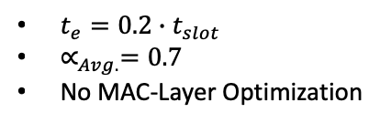
FSA with PHY-Layer Improvement
PHY-Layer
$t_{e}=0.2∙t_{slot}$
$∝_{Avg.}=0.7$
No MAC-Layer Optimization
FINALLY
Not yet!!
RFID
Optimized??
100%
RFID
RFID
36%
60%
MAC-Layer Optimization
Notes:
Although, the FSA reading efficiency increased by improving the physical layer, there still room for improvement by improving the MAC-layer.

Slide 12
Outline
01
RFID Reading Process
02
MAC-Layer Optimization Proposals
Tags Population Estimation
Frame Length Optimization
03
Improvements of the EPCglobal C1 G2 standard
04
Conclusion and Future Work
Notes:
The first step of the MAC layer optimization is to improve the tags population estimation algorithm.

Slide 13

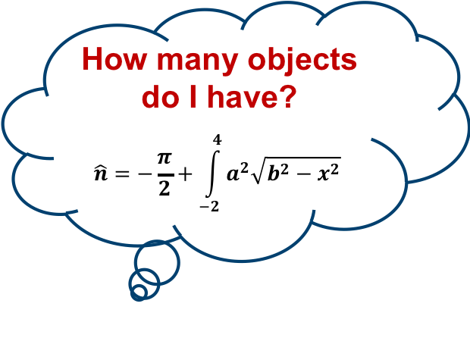
Tags Population Estimation
How many objects do I have?
$$\hat{n}=−\frac{π}{2}+\int_{−2}^{4}{a^{2}\sqrt{b^{2}−x^{2}} }$$
Notes:
Now the question is:
How Conventional FSA estimates the tags populations?

Slide 14
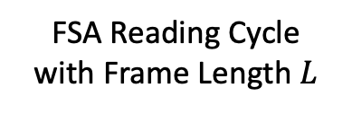
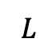

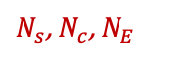

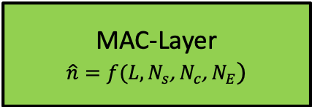
Tags Population Estimation Conventional System^{[1, 2]}
$$L$$
$$L$$
FSA
FSA Reading Cycle
with Frame Length $L$
S
C
E
C
C
S
$N_{s}\text{, }N_{c}$, $N_{E}$
$$L$$
Tags population
Estimation Function
MAC-Layer
$$\hat{n}=f(L,N_{s}\text{, }N_{c}\text{, }N_{E})$$
$$\hat{n}$$
[1] F. Schoute 1983.
[2] H. Vogt 2002.
Notes:
For every FSA reading cycle, a new frame length is defined.
The output of every reading cycle is the number of successful, collided and empty slots.
Then the MAC layer estimates the remaining number of tags as a function of the frame length and NS,NC, and NE

Slide 15


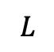
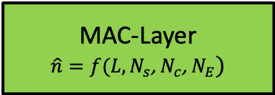

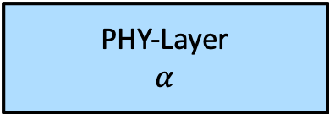
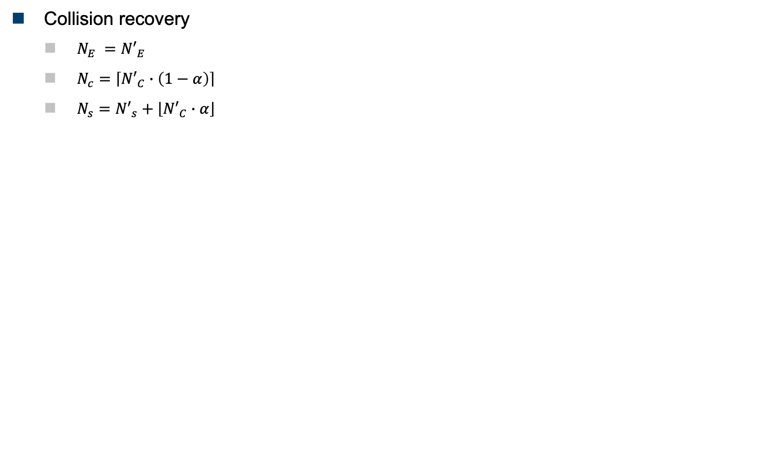

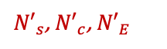
Tags Population Estimation Conventional System^{[1, 2]}
Collision recovery
$N_{E} ={N′}_{E}$
$N_{c}=\left\lceil {N′}_{C}∙\left(1−α\right)\right\rceil$
$N_{s}={N′}_{s}+\left\lfloor {N′}_{C}∙α\right\rfloor$
$$L$$
FSA
Before
Collision Recovery
${N′}_{s}\text{, }{N′}_{c}$, ${N′}_{E}$
$α$ is neglected in MAC calculations!!
PHY-Layer
$$α$$
After
Collision Recovery
$N_{s}\text{, }N_{c}$, $N_{E}$
MAC-Layer
$$\hat{n}=f(L,N_{s}\text{, }N_{c}\text{, }N_{E})$$
[1] F. Schoute 1983.
[2] H. Vogt 2002.
$$\hat{n}$$
Notes:
In the systems which have a collision recovery capabilities, the number of successful, collided and empty slots strongly depend on the collision recovery capability of the reader.
However, this information is neglected in the MAC layer calculations.

Slide 16
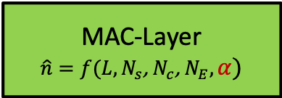
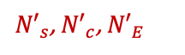
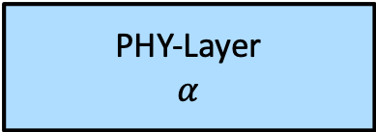


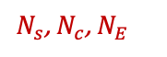
Tags Population Estimation Proposed System^{[5]}
Collision recovery
$N_{E} ={N′}_{E}$
$N_{c}=\left\lceil {N′}_{C}∙\left(1−α\right)\right\rceil$
$N_{s}={N′}_{s}+\left\lfloor {N′}_{C}∙α\right\rfloor$
$$L$$
FSA
Before
Collision Recovery
${N′}_{s}\text{, }{N′}_{c}$, ${N′}_{E}$
PHY-Layer
$$α$$
After
Collision Recovery
$$α$$
$N_{s}\text{, }N_{c}$, $N_{E}$
MAC-Layer
$$\hat{n}=f(L,N_{s}\text{, }N_{c}\text{, }N_{E},α)$$
[5] Hazem A. Ahmed et al, 2014
$$\hat{n}$$
Notes:
In THE PROPOSED ESTIMATION FUNCTION, the collision recovery capability of the physical layer is considered.

Slide 17

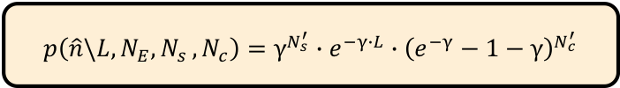
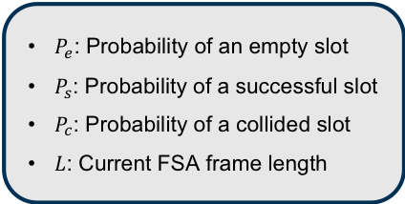
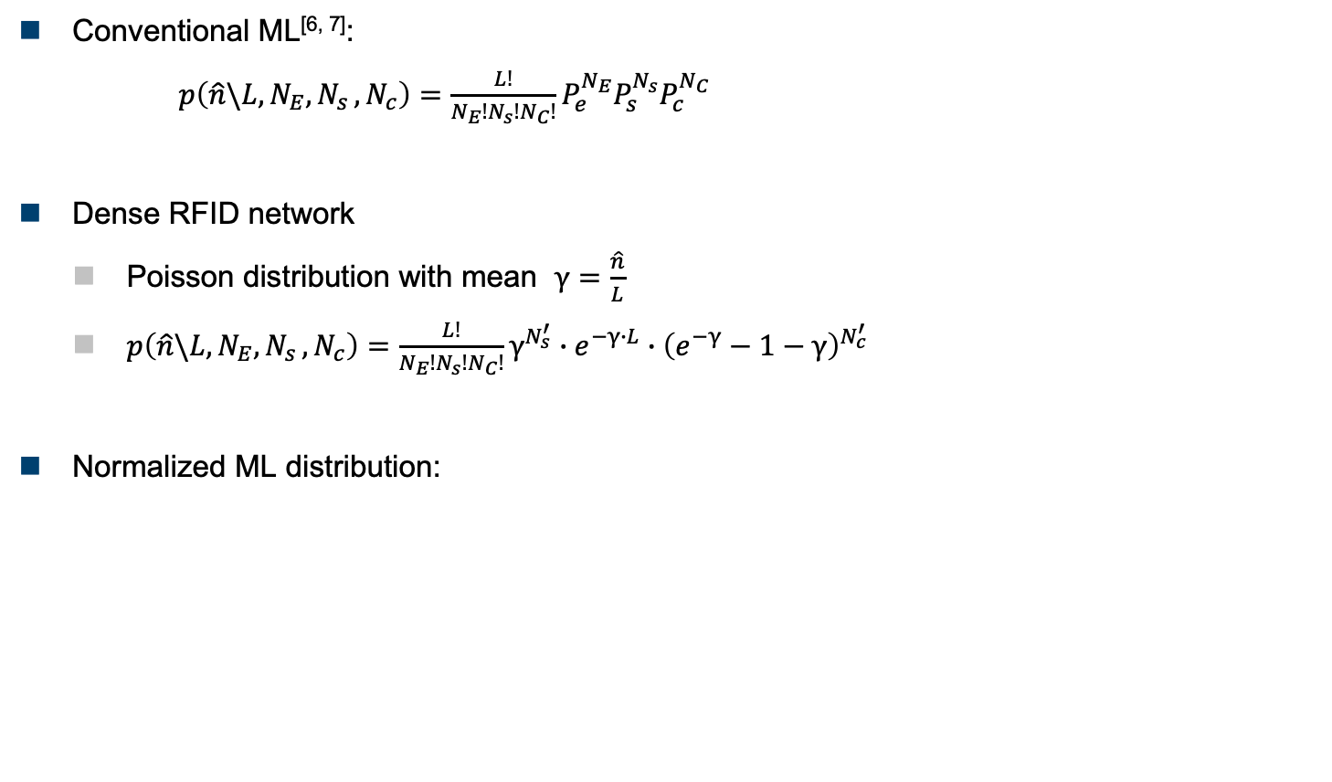
Tags Population Estimation Proposed System^{[5]}
Conventional ML^{[6, 7]}:
$p\left(\hat{n}\backslash {L,N}_{E}{, N}_{s},N_{c}\right)=\frac{L!}{N_{E}!N_{s}!N_{C}!}P_{e}^{N_{E}}P_{s}^{N_{s}}P_{c}^{N_{C}}$
Dense RFID network
Poisson distribution with mean $γ=\frac{\hat{n}}{L}$
$p\left(\hat{n}\backslash {L,N}_{E}{, N}_{s},N_{c}\right)=\frac{L!}{N_{E}!N_{s}!N_{C}!}γ^{N_{s}^{′}}∙e^{−γ∙L}∙{\left(e^{−γ}−1−γ\right)}^{N_{c}^{′}}$
Normalized ML distribution:
$P_{e}$: Probability of an empty slot
$P_{s}$: Probability of a successful slot
$P_{c}$: Probability of a collided slot
$L$: Current FSA frame length
$$p\left(\hat{n}\backslash {L,N}_{E}{, N}_{s},N_{c}\right)=γ^{N_{s}^{′}}∙e^{−γ∙L}∙{\left(e^{−γ}−1−γ\right)}^{N_{c}^{′}}$$
[5] Hazem A. Ahmed et al, 2014
[6] W.-T. Chen Chen 2009.
[7] E. Vahedi et al 2011.
Notes:
The above equation presents the ML number of tags estimation function which is proposed in the state of the art.
The equation finds the optimum number of tags n that gives exact NE, Ns, Nc times in L trials.
For dense RFID network, Poisson distribution could be used
After normalization, the ML equation could be written as shown
However, the numerical searching in this eq. limits the number of tags.
Moreover, the equation still doesn't consider the collision recovery capability effect of the PHY-layer.

Slide 18
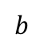
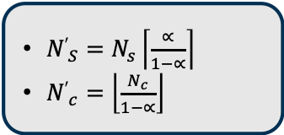
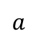
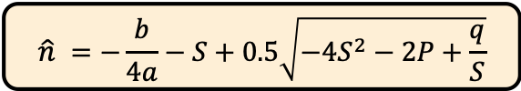
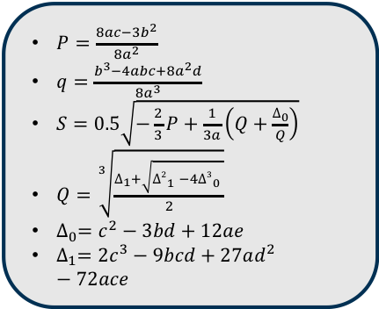
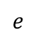
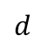
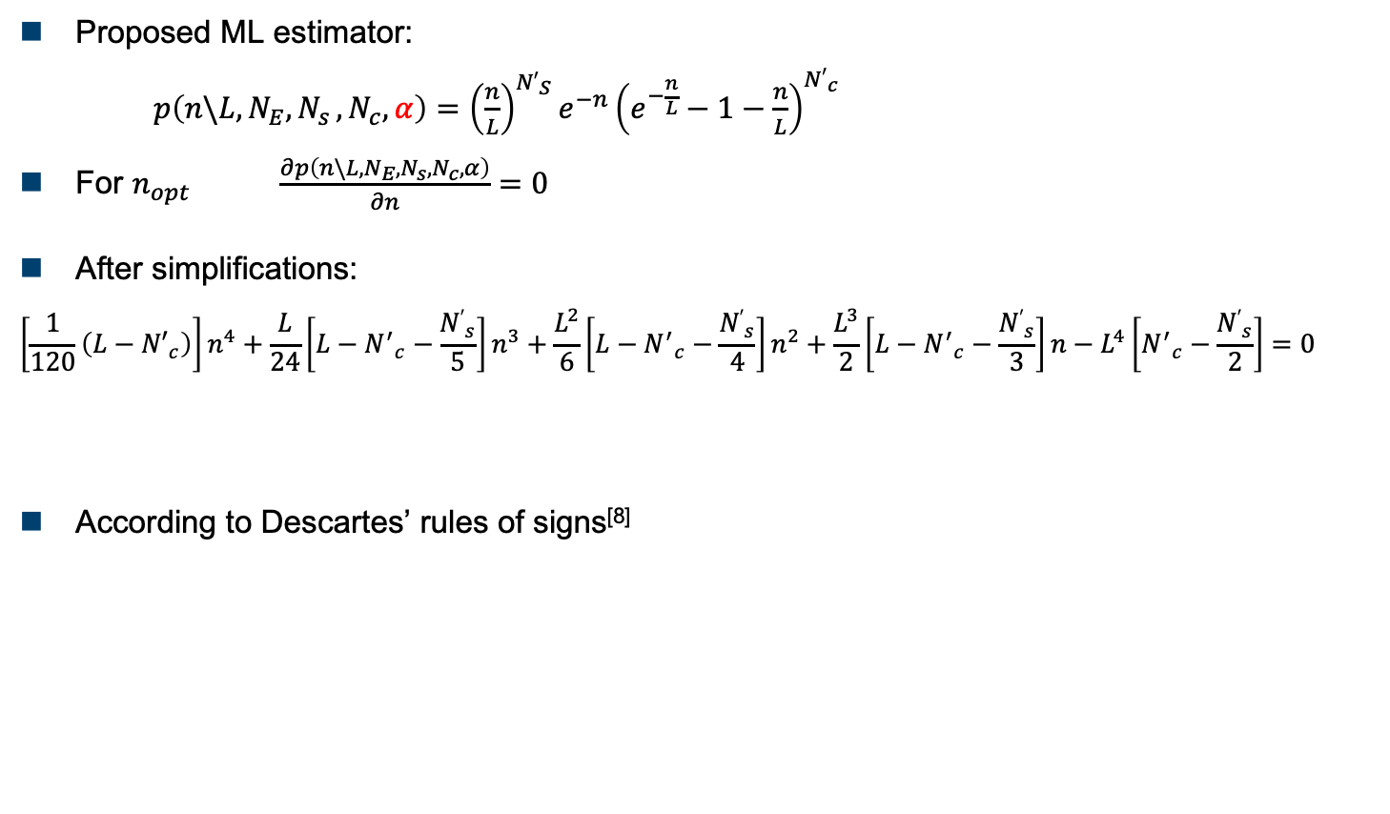
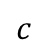
Tags Population Estimation Proposed System^{[5]}
Proposed ML estimator:
$p\left(n\backslash {L,N}_{E}{, N}_{s},N_{c},α\right)={\left(\frac{n}{L}\right)}^{{N′}_{S}}e^{−n}{\left(e^{−\frac{n}{L}}−1−\frac{n}{L}\right)}^{{N′}_{c}}$
For $n_{opt}$ $\frac{∂p\left(n\backslash {L,N}_{E}{, N}_{s},N_{c},α\right)}{∂n}=0$
After simplifications:
$$\left[\frac{1}{120}\left(L−{N′}_{c}\right)\right]n^{4}+\frac{L}{24}\left[L−{N^{′}}_{c}−\frac{{N′}_{s}}{5}\right]n^{3}+\frac{L^{2}}{6}\left[L−{N^{′}}_{c}−\frac{{N′}_{s}}{4}\right]n^{2}+\frac{L^{3}}{2}\left[L−{N^{′}}_{c}−\frac{{N′}_{s}}{3}\right]n−L^{4}\left[{N^{′}}_{c}−\frac{{N′}_{s}}{2}\right]=0$$
According to Descartes’ rules of signs^{[8]}
${N′}_{S}=$ $N_{s}\left\lceil \frac{∝}{1−∝}\right\rceil$
${N′}_{c}=\left\lfloor \frac{N_{c}}{1−∝}\right\rfloor$
$$a$$
$$b$$
$$c$$
$$d$$
$$e$$
$P=\frac{8ac−3b^{2}}{8a^{2}}$
$q=\frac{b^{3}−4abc+8a^{2}d}{8a^{3}}$
$S=0.5\sqrt{−\frac{2}{3}P+\frac{1}{3a}\left(Q+\frac{∆_{0}}{Q}\right)}$
$Q=\sqrt[3]{\frac{∆_{1}+\sqrt{{∆2}_{1}^{}−4{∆3}_{0}^{}}}{2}}$
$∆_{0}=c^{2}−3bd+12ae$
$∆_{1}={2c}^{3}−9bcd+27ad^{2}−72ace$
$$\hat{n} =−\frac{b}{4a}−S+0.5\sqrt{−4S^{2}−2P+\frac{q}{S}}$$
[5] Hazem A. Ahmed et al, 2014
[8] D. Struik, A Source Book in Mathematics 1986
Notes:
Therefore, a new ML estimation function is presented. Which considers the collision recovery capability of the reader
To calculate the optimum number of tags from the above equation, we have to differentiate the equation with respect to n
After simplification we reached to a 4th order equations with 4 solutions.
Using Descertes’ rules of sign, We can prove that the equation has a single valid real positive solution.

Slide 19
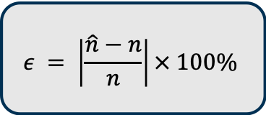
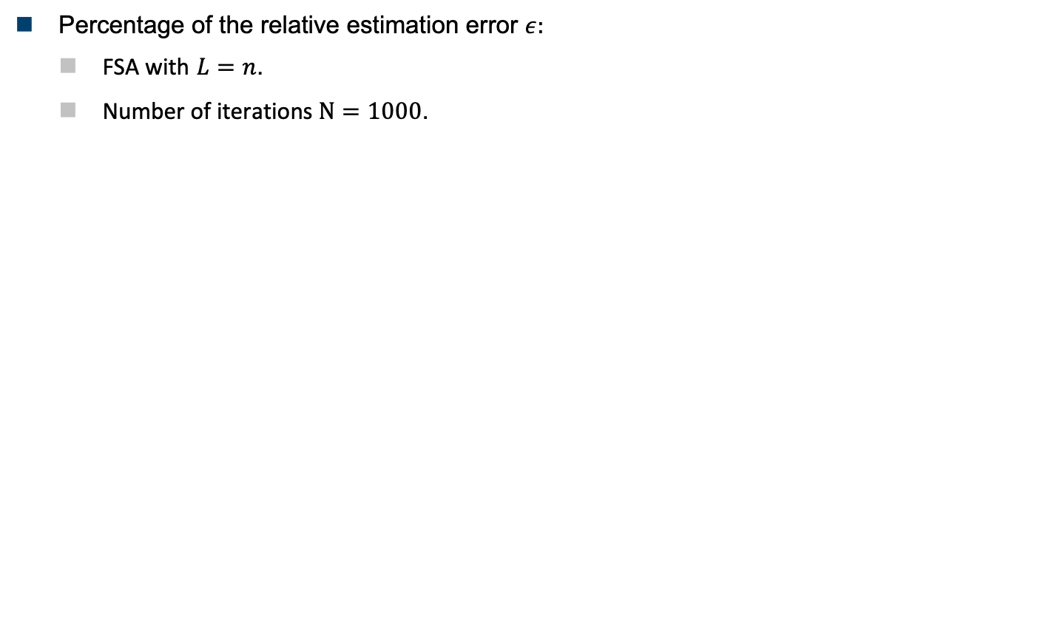
Tags Population Estimation Simulations results ^{[5]}
Percentage of the relative estimation error $ε:$
FSA with $L=n$.
Number of iterations $Ν=1000$.
$$ε = \left|\frac{\hat{n}−n}{n}\right|× 100\%$$
[5] Hazem A. Ahmed et al, 2014
Notes:
This graph shows the percentage of the relative estimation error of the proposed formula compared to the most popular estimation algorithms in the state of the art.
The graph shows the effect of the collision recovery capability on the relative estimation error.
According to the simulations results, the proposed formula gives the best performance compared to the other algorithms.

Slide 20

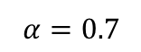

Tags Population Estimation Simulations results ^{[5]}
Mean identification time for $n$ number of tags:
FSA with $L=n$, $α_{Avg.}=0.7$
Number of iterations $Ν=1000$.
30%
[5] Hazem A. Ahmed et al, 2014
Notes:
In dense RFID applications, the total identification time is the most important performance metric.
The presented results use FSA with L=n and 0.7 average collision recovery probability
Accordingly, the proposed formula gives the best performance compared to the state of the art.
Nevertheless, there is around 30% room of improvement to reach the theoretical lower limit of FSA.

Slide 21

FSA after Tags Population Estimation
PHY-Layer
$t_{e}=0.2∙t_{slot}$
$∝_{Avg.}=0.7$
No MAC-Layer Optimization
Estimation
$∝_{Avg.}=0.7$
Closed Form Solution
No frame length optimization
RFID
RFID
RFID
70%
36%
60%
Notes:
Therefore, the FSA reading efficiency after the proposed ML tags populations estimation and average alpha 0.7 is increased by 10%.
This is without Frame length optimization

Slide 22
Outline
01
RFID Reading Process
02
MAC-Layer Optimization Proposals
Tags Population Estimation
Frame Length Optimization
03
Improvements of the EPCglobal C1 G2 standard
04
Conclusion
Notes:
The second step of the MAC layer optimization is to incorporate the physical layer parameters with the frame length optimization.

Slide 23














Frame Length Optimization
$L=6$, $η=30\%$
S
C
E
C
C
S
Time Aware
$$Tslot$$
$$Tslot$$
$$Tslot$$
$$L$$
Time Aware & Collision Recovery
S
E
S
E
E
S
E
S
E
$L$ or
$L=9$, $η=50\%$
$L=9$, $η_{t}=50\%$
S
E
S
E
E
S
E
S
E
$$TS$$
$$Te$$
S
C
E
C
C
S
$L=6$, $η=30\%$
Collision Recovery
$$L$$
C
E
C
C
S
E
S
S
$$L=4, η=75\%$$
Notes:
Let's assume that we have a system that has only Time aware capability. It is better to increase the frame length as the losses from the empty slots are so small.
On the other hand, if the system has only collision recovery capability, so it is better to decrease the frame length as the reader can benefit from collided slots.
So what would be the optimum frame length if the system has both time aware and collision recovery capability?
To answer this question, different PHY--layer scenarios will be presented and the corresponding frame length for each scenario will be calculated.

Slide 24










Frame Length Optimization Conventional System^{[1,2]}
Reading efficiency:
$η_{conv.}=\frac{N_{s}}{N_{s}+N_{c}+N_{E}}=\frac{N_{s}}{L}$
For optimum frame length
$\frac{∂η_{conv.}}{∂L}=0$
Conventional FSA optimum frame length:
S
C
E
C
C
S
$$Tslot$$
$$Tslot$$
$$Tslot$$
$$α=0$$
$$t_{s}=t_{c}=t_{e}$$
$$L_{conv.}=n$$
S
C
E
C
C
S
$$Tslot$$
$$Tslot$$
$$Tslot$$
[1] F. Schoute 1983.
[2] H. Vogt 2002.
Notes:
In the conventional FSA:
The slots durations are constant
The collision recovery probability is zero
The optimum frame length is L=n.

Slide 25






Frame Length Optimization Time Aware System^{[9]}
Reading efficiency:
$η_{TA}=\frac{N_{s}⋅t_{s}}{N_{s}⋅t_{s}+N_{c}⋅t_{c}+N_{E}⋅t_{e}}$
For optimum frame length
$\frac{∂η_{TA}}{∂L}=0$
After simplifications:
${\left(\frac{L_{TA}}{n}\right)}^{2}C_{t}−\left(\frac{L_{TA}}{n}\right)C_{t}+0.5\left(C_{t}−1\right)=0$,
where, $C_{t}=\frac{t_{e}}{t_{c}}$ is the slot duration constant
Proposed Time Aware Frame Length:
S
C
E
C
C
S
$$Tslot$$
$$Tslot$$
$$Tslot$$
$$α=0$$
$$t_{s}>t_{c}>t_{e}$$
S
C
E
C
C
S
$$tS$$
$$tc$$
$$te$$
$$L_{TA}=\frac{n}{2}\left(1+\sqrt{\frac{2}{C_{t}}−1}\right)$$
[9] Hazem A. Ahmed et al, 2016
Notes:
In time aware system:
The slots durations are different
The collision recovery probability is zero
Thus, the reading efficiency should be presented as shown
To calculate the optimum frame length, we have to differentiate the reading efficiency with respect to L. and equate the result to zero
After simplification we reached this closed form solution.

Slide 26

Frame Length Optimization Time Aware System^{[9]}
Frame length comparison
Number of tags $n=100$
$C_{t}$: Slot duration constant
[9] Hazem A. Ahmed et al, 2016
Notes:
These graphs show the optimum Time aware frame length using the numerical solution compared to the proposed formula in the complete range of the slot duration constant.
In the simulations, a fixed number of tags are used, which are 100 tags.
According to the graph, the proposed formula approaches the numerical results with a small bias coming from the Taylor series approximation during the proof.
According to the RFID standards, the frame length can take only quantized values (power of 2), which remove the effect of the approximation.

Slide 27


Frame Length Optimization Time Aware System^{[9]}
Percentages of the mean reading time reduction
FSA using $L_{TA}$ compared to $L_{conv.}$
1000 iterations
$C_{t}=0.2$
$$ζ= \left(\frac{T_{conv}−T_{pro}}{T_{conv}}\right)× 100\%$$
[9] Hazem A. Ahmed et al, 2016
Notes:
To emphasize the gain of the proposed system, the mean reading time reduction using the proposed time aware frame length compared to the conventional FSA frame length is presented.
In the simulation results, different estimation algorithms are used
using the proposed ML estimation as an example, the Time aware system gives 8% reading time reduction compared to the conventional systems.
According to the graph, the better estimation algorithm, the less reading time reduction, because good estimation algorithms decrease the number of iterations of FSA process.

Slide 28






Frame Length Optimization Time and Collision Recovery Aware System^{[10]}
Reading efficiency:
$η_{TCA}=\frac{\left(N_{s}+α∙N_{c}\right)⋅t_{s}}{\left(N_{s}+α∙N_{c}\right)⋅t_{s}+N_{c}∙\left(1−α\right)⋅t_{c}+N_{E}⋅t_{e}}$
For optimum frame length
$\frac{∂η_{TCA}}{∂L}=0$
After simplifications
$${\left(\frac{L_{TCA}}{n}\right)}^{2}C_{t}−\left(\frac{L_{TCA}}{n}\right)C_{t}−0.5\left(1−α\right)∙\left(1−C_{t}\right)=0$$
where, $C_{t}=\frac{t_{e}}{t_{c}}$ is the slot duration constant
The proposed formula:
S
C₂
E
C₄
C₃
S
$$Tslot$$
$$Tslot$$
$$Tslot$$
0$≤α≤1$
$$t_{s}>t_{c}>t_{e}$$
S
S
E
C₄
S
S
$$tS$$
$$te$$
$$tc$$
$$L_{TCA}=\frac{n}{2}\left(\left(1−α\right)+\sqrt{{\left(1−α\right)}^{2}+\frac{2}{C_{t}}\left(1−α\right)∙\left(1−C_{t}\right)}\right)$$
[10] Hazem A. Ahmed et al, 2015
Notes:
In this proposal
The slots durations are different
and The collision recovery probability is between zero and one depending on the PHY-Layer
However, the collision recovery coefficients are assumed to be constant.
which means that the probabilities of recovering a collided slot with 2,3,or 4 collided tags are equal
So, the reading efficiency should consider the timing and the collision recovery capabilities.
To calculate the optimum frame, we have to differentiate the reading efficiency with respect to L.
After simplification we get this closed form solution.

Slide 29

Frame Length Optimization Time and Collision Recovery Aware System ^{[10]}
Frame length comparison
Number of tags $n=100$
$α$: The collision recovery capability
$C_{t}$: Slot duration constant
[10] Hazem A. Ahmed et al, 2015
Notes:
These graphs show the optimum Time and collision recovery aware frame length using the numerical solution compared to the proposed formula in the complete range of the slot duration constant.
According to the graph, the proposed formula approaches the numerical results with a small bias coming from the Taylor series approximation during the proof.
As I said before, the frame length can take only quantized values (power of 2), which remove the effect of the approximation.

Slide 30

Frame Length Optimization Time and Collision Recovery Aware System ^{[10]}
Percentages of the mean reading time reduction
FSA using $L_{TCA}$ compared to $L_{conv.}$
1000 iterations
$C_{t}=0.2, α=0.7$
[10] Hazem A. Ahmed et al, 2015
Notes:
This graph shows the mean reading time reduction using the proposed time and collision recovery aware frame length compared to the conventional FSA frame length.
Using the proposed ML estimation, the Time and collision recovery aware system gives 17% reading time reduction compared to the conventional systems.

Slide 31











Frame Length Optimization Multiple Collision Recovery Coefficients Aware System^{[11]}
Reading efficiency
$η_{MCRC}=P\left(1\right)+\sum_{i=2}^{k}{α_{i}∙P(i)},$
where, $k$ is the number of collided tags per slot
After approximations:
$η_{MCRC}≈P\left(1\right)+α_{2}∙P(2)\text{+} α_{3}∙P(3)\text{+}{ α}_{4}∙P(4)$
S
C₂
E
C₃
C₄
S
$$Tslot$$
$$Tslot$$
$$Tslot$$
$$\frac{n}{2}≤L≤2n$$
$$t_{s}=t_{c}=t_{e}$$
0$≤α_{2,3,4}≤1$
$$≈96\%$$
S
S
E
S
C₄
S
$$Tslot$$
$$Tslot$$
$$Tslot$$
[11] Hazem A. Ahmed et al, 2017
Notes:
In this proposal, the differences in slots durations are neglected.
However, Multiple collision recovery coefficients are considered. Which means that the probability of recovering a slot with 2 collided tags is higher than the probability of recovering a slot with 3 and 4 collided tags.
This graph presents the distribution of the average collision probability in a frame length between n/2 and 2n uniformly.
According to the graph, the probability that collided slot comes from 2,3,or 4 tags is 96%
Thus, for practical RFID systems, the reading efficiency could be expressed as.

Slide 32








Frame Length Optimization Multiple Collision Recovery Coefficients Aware System^{[11]}
Reading efficiency
$η_{MCRC}=P\left(1\right)+α_{2}∙P(2)$+ $α_{3}∙P(3)$+${ α}_{4}∙P(4)$
For optimum frame length
$\frac{∂η_{MCRC}}{∂L}=0$
After simplifications:
$$1∙{\left(\frac{L}{n}\right)}^{4}+\left(α_{2}−1\right){\left(\frac{L}{n}\right)}^{3}+\frac{\left(α_{3}−α_{2}\right)}{2}{\left(\frac{L}{n}\right)}^{2}+\frac{\left(α_{4}−α_{3}\right)}{6}\left(\frac{L}{n}\right)−\frac{α_{4}}{24}=0$$
The proposed formula:
$$a$$
$$b$$
$$c$$
$$d$$
$$e$$
Where:
$P=\frac{8ac−3b^{2}}{8a^{2}}$
$q=\frac{b^{3}−4abc+8a^{2}d}{8a^{3}}$
$S=0.5\sqrt{−\frac{2}{3}P+\frac{1}{3a}\left(Q+\frac{∆_{0}}{Q}\right)}$
$Q=\sqrt[3]{\frac{∆_{1}+\sqrt{{∆2}_{1}^{}−4{∆3}_{0}^{}}}{2}}$
$∆_{0}=c^{2}−3bd+12ae$
$∆_{1}={2c}^{3}−9bcd+27ad^{2}−72ace$
$$L_{MCRC}=\left(−\frac{b}{4a}−S+0.5\sqrt{−4S^{2}−2P−\frac{q}{S}}\right)⋅n$$
[11] Hazem A. Ahmed et al, 2017
Notes:
To calculate the optimum frame, we have to differentiate the reading efficiency with respect to L.
After simplification we get this closed form solution.

Slide 33

Frame Length Optimization Multiple Collision Recovery Coefficients Aware System^{[11]}
Example of the average collision recovery coefficients
Strongest Tag reply receiver^{[12]}
$α_{i}=\left(1−{PER}_{i}\right)$, where $i$ is the number of collided tags.
SNR: Average signal to noise ratio
[11] Hazem A. Ahmed et al, 2017
[12] H. Salah 2015.
Notes:
Now, an example of the calculation of the collision recovery coefficients will be clarified.
The values of these coefficients strongly depend on the receiver type.
these simulations use the strongest tag reply receiver from the state of the art.
The collision recovery coefficient $α_{i}$ could be calculated by (1- the packet error rate of the i tag replies)
According to the graph, the probability of recovering a slot from two collided tags is higher than the probability of recovering a slot from 3 or 4 collided tags

Slide 34

Frame Length Optimization Multiple Collision Recovery Coefficients Aware System^{[11]}
Frame length comparison
Strongest Tag reply receiver^{[12]}
SNR: Average signal to noise ratio
1000 iteration for the numerical solution
$${L_{MCRC}}/{n }$$
[11] Hazem A. Ahmed et al, 2017
[12] H. Salah 2015.
Notes:
This graph shows the optimum multiple collision recovery aware frame length using the numerical solution compared to the proposed formula in different SNR.
The simulations are based on the strongest tag reply receiver which is discussed in the previous slide.
According to the graph, the proposed formula gives identical values compared to the numerical values.

Slide 35

Frame Length Optimization Multiple Collision Recovery Coefficients Aware System^{[11]}
Percentages of the mean reading time reduction
FSA using $L_{MCRC}$ compared to $L_{conv.}$ (1000 iterations)
$SNR=10$ dB (strongest tag reply receiver)
$α_{2}=0.6, α_{3}=0.5, α_{4}=0.4$
[11] Hazem A. Ahmed et al, 2017
Notes:
Regarding the the mean reading time reduction
Using the proposed ML estimation function, the multiple collision recovery coefficients system gives 13% reading time reduction compared to the conventional systems.
The simulation results use the strongest tag reply receiver at SNR=10dB

Slide 36






Frame Length Optimization Time and Multiple Collision Recovery Coefficients Aware System
Reading efficiency:
$η_{TAMCRC}=\frac{P\left(1\right)+α_{2}∙P(2)+α_{3}∙P(3)}{1+P(0)⋅\left(C_{t}−1\right)}$
For optimum frame length
$\frac{∂η_{TAMCRC}}{∂L}=0$
S
C₂
E
C₄
C₃
S
$$Tslot$$
$$Tslot$$
$$Tslot$$
0$≤α_{2,3}≤1$
$$t_{s}>t_{c}>t_{e}$$
S
S
E
C₄
S
S
$$tS$$
$$te$$
$$tc$$
Notes:
In this proposal, the differences in slots durations in addition to the multiple collision recovery coefficients are considered.
So, the reading efficiency should consider the timing and the collision recovery properties.
To calculate the optimum frame, we have to differentiate the reading efficiency with respect to L.

Slide 37








Frame Length Optimization Time and Multiple Collision Recovery Coefficients Aware System^{[13]}
After simplifications:
$$−C_{t}∙{\left(\frac{L}{n}\right)}^{4}+\left(C_{t}∙\left(1−α_{2}\right)−1\right){\left(\frac{L}{n}\right)}^{3}+\left(2−C_{t}−α_{2}+\frac{C_{t}}{2}\left(α_{2}−α_{3}\right)\right){\left(\frac{L}{n}\right)}^{2}+\left(\frac{\left(α_{2}−α_{3}\right)}{2}+\frac{α_{2}}{2}\left(1−C_{t}\right)\right)\left(\frac{L}{n}\right)$$
$$−\frac{α_{3}}{6}\left(2−C_{t}\right)=0$$
The proposed formula:
$$a$$
$$b$$
$$c$$
$$d$$
$$e$$
Where:
$P=\frac{8ac−3b^{2}}{8a^{2}}$
$q=\frac{b^{3}−4abc+8a^{2}d}{8a^{3}}$
$S=0.5\sqrt{−\frac{2}{3}P+\frac{1}{3a}\left(Q+\frac{∆_{0}}{Q}\right)}$
$Q=\sqrt[3]{\frac{∆_{1}+\sqrt{{∆2}_{1}^{}−4{∆3}_{0}^{}}}{2}}$
$∆_{0}=c^{2}−3bd+12ae$
$∆_{1}={2c}^{3}−9bcd+27ad^{2}−72ace$
$$L_{TAMCRC}=\left(−\frac{b}{4a}−S+0.5\sqrt{−4S^{2}−2P−\frac{q}{S}}\right)⋅n$$
[13] Hazem A. Ahmed et al, 2016
Notes:
After simplification we get this closed form solution.

Slide 38

Frame Length Optimization Time and Multiple Collision Recovery Coefficients Aware System^{[13]}
Frame length comparison
Number of tags $n=100$
$α_{2},$ $α_{3 }$ collision recovery probability for two, three collided tags per slot
$C_{t}$: Slot duration constant
[13] Hazem A. Ahmed et al, 2016
Notes:
These graphs show the optimum Time and multiple collision recovery aware frame length using the numerical solution compared to the proposed formula in the complete range of the slot duration constant.
According to the quantized frame lengths concept, the proposed formula gives identical results to the numerical solution.

Slide 39


Frame Length Optimization Time and Multiple Collision Recovery Coefficients Aware System^{[13]}
Percentages of the mean reading time reduction
FSA using $L_{TAMCRC}$ compared to $L_{conv.}$
1000 iterations
$C_{t}=0.2, α_{2}=0.6{,α}_{3}=0.5$
$ζ_{TAMCRC}$ [%]
[13] Hazem A. Ahmed et al, 2016
Notes:
Regarding the the mean reading time reduction
Using the proposed ML estimation, the Time and the multiple collision recovery aware system gives 20% reading time reduction compared to the conventional systems.

Slide 40

Frame Length Optimization Comparison between the Proposed Algorithms [ML estimation]
Mean identification time
FSA with 1000 iterations
Strongest tag reply receiver^{[11]} ($SNR=10dB$) $α_{2}=0.6, α_{3}=0.5$
Slots durations^{[14]} $t_{S}=1060μs$, $t_{c}=300μs$, $t_{e}=60μs$ $C_{t}=0.2$
[11] H. Salah 2015.
[14] EPC radio-frequency protocols 2006.
Notes:
This graph shows the mean identification time for the all proposed Algorithms compared to the conventional FSA and the theoretical lower limit
The simulation results use the strongest tag reply receiver at SNR=10dB and the used slots durations are from the EPC standard
According to the simulation results, the more physical layer parameters are considered, the less identification time is needed.

Slide 41

FSA after Frame Length Optimization
PHY-Layer
Time Aware
Collision Recovery Aware
No MAC-Layer Optimization
Estimation
$∝_{Avg.}=0.7$
Closed Form Solution
No frame length optimization
Frame length optimization
$α_{2}=0.6, α_{3}=0.5, α_{4}=0.4$
$C_{t}=0.2$
Closed Form Solutions
RFID
RFID
90%
RFID
RFID
70%
36%
60%
Notes:
Therefore, the FSA reading efficiency after incorporating the physical layer parameters to the number of tags estimation and the frame length optimization reaches to 90%.
All these improvements are on the reader side without any modification in the communication protocol between the reader and tags to follow the EPCglobal standard.

Slide 42
Outline
01
RFID Reading Process
02
MAC-Layer Optimization Proposals
Tags Population Estimation
Frame Length Optimization
03
Improvements of the EPCglobal C1 G2 standard
04
Conclusion
Notes:
In this part new improvements for the EPCglobal C1 G2 standard will be presented.
Which means that upcoming modifications will be in the communication protocol between the reader and the tags.

Slide 43


Collided Slot in EPCglobal C1G2
Without collision recovery
With collision recovery
Reader
Tags
S
E
C
E
S
C
E
S
Query command
$$t_{c}$$
Can we Acknowledge more than
one tag per slot?
Tag₁+Tag₂+….Tag_{k}
Query
$L=9$, $η=50\%$
Discard all tags
Query-Rep
time
Reader
Tags
S
E
S
E
E
E
S
S
C
S
C
S
E
E
C
C
Query command
C
$$t_{c}$$
Tag₁+Tag₂+….+Tag_{k}
Query
ACK₁
+ EPC₁
ACK single tag
ACK₁
EPC₁
Query-Rep
time
Notes:
To clarify the motivation of the proposed improvements, I will discuss the behavior of the EPCglobal C1 G2 standard with collided slots.

Slide 44












Proposed Improvements of the EPCglobal C1 G2^{[15]}
Reader
Tags
Query command
12 bits
6 bits
16 bits
$$tsa$$
Pilot (optional)
preamble
RN16
Tag₁+Tag₂+….+Tag_{k}
8 bits
- Counts the number of resolved tags ${(R}_{sol})$
- Sends the first ACK command
Conventional pilot
$$P1$$ | 0 0 0 0 0 0 0 0
$$P18$$ | 0 0 0 1 0 0 0 1
$$P69$$ | 0 1 0 0 0 1 0 0
$$P86$$ | 0 1 0 1 0 1 0 1
$$P171$$ | 1 0 1 0 1 0 1 0
$$P188$$ | 1 0 1 1 1 0 1 1
$$P239$$ | 1 1 1 0 1 1 1 0
$$P256$$ | 1 1 1 1 1 1 1 1
ACK1
S
E
C
E
S
C
E
S
$$tsb$$
EPC₁
$(Rsol−1)$tags
Wait state
Query
ACK₁
+ EPC₁
ACK$Rsol$
+ EPC_{R}$sol$
8-bits orthogonal pilot ^{[16]}
$$tsa$$
$$tsb$$
ACK$Rsol$
$$tsb$$
EPC$Rsol$
No tag
Wait state
Pseudo parallel slot duration
$$tpps=tsa+Rsol∙tsb$$
time
[15] Hazem A. Ahmed et al, 2015
[16] J. Kaitovic 2012
Notes:
In the proposed system:
the reader sends a query command asking the tags to reply to this slot.
let's assume that k tags replies to this slot.
Each tags chooses randomly one orthogonal pilot from the available ones.
The reader count the number of resolved tags and acknowledge them one after one until acknowledging all the resolve tags.
This concept is called pseudo parallel slot. Which consists of parallel part includes the query and the RN16 replies, and series part includes the Acknowledgments.

Slide 45








Proposed Improvements of the EPCglobal C1 G2^{[15]}
Conventional FSA
$$P\left(R\right)=\left({n \atop R}\right)∙{\left(\frac{1}{L}\right)}^{R}∙{\left(1−\frac{1}{L}\right)}^{n−R}$$
$$ηcon={\left.P\left(R\right)\right|}_{R=1}$$
Multiple ACKs
$$ηMA=\sum_{R=1}^{M}{P\left(R\right)∙R_{sol.}}$$
$$M\text{: }\text{Number} \text{of} \text{orthogonal} \text{codes}$$
$$R_{sol.}\text{: }\text{Number} \text{of} \text{recovered} \text{tags}$$
$$ηUS=\sum_{R=1}^{M}{P\left(R\right)∙R_{sol.}}PS1$$
$P_{S1}$: Probability that each replied tag uses a unique orthogonal pilot
ACK if Unique
Scenario
$$ηProposed=\sum_{R=1}^{M}{P\left(R\right)∙R_{sol.}∙PS1∙φ}$$
$$φ =\left(\frac{ts}{tsa+tsb∙Rsol}\right)$$
Pseudo parallel
Slot
[15] Hazem A. Ahmed et al, 2015
Notes:
To calculate the reading efficiency of the proposed system.
The conventional reading efficiency of the FSA is the probability of receiving single tag reply.
In the proposed system, the reader has the capability to resolve up to M collided tags.
Furthermore, every tag reply has to have a unique orthogonal pilot
Finally, the proposed successful slot is pseudo parallel slot. So the efficiency should be multiplied by phay.

Slide 46
Proposed Improvements of the EPCglobal C1 G2^{[15]}
Mean identification time
Modified (Tags/Reader) compared to the state-of-the-art
Maximum length of pseudo parallel slot is 8 tags
FSA with 1000 iterations
[15] Hazem A. Ahmed et al, 2015
Notes:
This Graph shows the mean identification time of the proposed solution compared to the most popular state of the art which propose a system that can ack all the two collided tags.
The proposed system approached the theoretical lower limit of the FSA.

Slide 47
FSA after the EPCglobal C1 G2 Improvements
PHY-Layer
Time Aware
Collision Recovery Aware
No MAC-Layer Optimization
Estimation
$∝_{Avg.}=0.7$
Closed Form Solution
No frame length optimization
Frame length optimization
$α_{2}=0.6, α_{3}=0.5, α_{4}=0.4$
$C_{t}=0.2$
Closed Form Solutions
RFID
RFID
Modified
EPCglobal C1 G2
8 tags pseudo parallel slot
100%
RFID
90%
RFID
RFID
70%
36%
60%
Notes:
Put references for this improvement

Slide 48
Outline
01
RFID Reading Process
02
MAC-Layer Optimization Proposals
Tags Population Estimation
Frame Length Optimization
03
Improvements of the EPCglobal C1 G2 standard
04
Conclusion
Notes:
As a conclusion

Slide 49
Conclusion
01
Advanced RFID Readers
Minimize the mean identification time for dense RFID system
02
MAC-layer optimization
Incorporate the PHY-layer parameters. [Time Aware, Collision Recovery]
03
Closed form Solution
No numerical searches. suits dense RFID applications
04
EPCglobal C1 G2 Improvements
Pseudo parallel slot. Approaches the FSA theoretical lower limit
Notes:
Advanced RFID readers which aim to minimize the mean identification time of dense RFID system are presented.
In the proposed systems, the MAC layer is optimized by incorporating the PHY-layer parameters.
For every proposal, a closed form solution is derived to suite the dense RFID applications.
Last but not least, NEW improvements for the EPCglobal C1 G2 standard are presented. Using these improvements, we can approach the FSA theoretical lower limit

Slide 50

Hazem Elsaid Ibrahim
hazem.a.elsaid@fau.de

Slide 51
Frame Length Optimization Comparison between the Proposed Algorithms [simple estimation]
Mean identification time
FSA with 1000 iterations
Strongest tag reply receiver^{[11]} ($SNR=10dB$) $α_{2}=0.6, α_{3}=0.5$
Slots durations^{[14]} $t_{S}=1060μs$, $t_{c}=300μs$, $t_{e}=60μs$ $C_{t}=0.2$
[11] H. Salah 2015.
[14] EPC radio-frequency protocols 2006.
Notes:
This graph shows the mean identification time for the all proposed Algorithms compared to the conventional FSA and the theoretical lower limit
The simulation results use the strongest tag reply receiver at SNR=10dB and the used slots durations are from the EPC standard
According to the simulation results, the more physical layer parameters are considered, the less identification time is needed.

Slide 52




Adaptive Decision Collision Recovery System
System Without Collision Recovery | System With Collision Recovery
$η_{TA}=\frac{N_{s}⋅T_{s}}{N_{s}⋅T_{s}+N_{E}⋅T_{e}+N_{c}⋅T_{c}}$ | $η_{TCR}=\frac{\left(N_{s}+α∙N_{c}\right)⋅T_{s}}{\left(N_{s}+α∙N_{c}\right)⋅T_{s}+N_{E}⋅T_{e}+N_{c}\left(1−α\right)⋅T_{C}}$
Initialize: frame length
Initialize: frame length
Observe: (Collided- Successful- Empty) slots
Observe: (Collided- Successful- Empty) slots
End
yes
Collided & Successful slots =0
End
yes
Collided & Successful slots =0
No
No
Receive the PHY-Layer parameters:
Timing parameters (Slots durations)
Receive the PHY-Layer parameters:
Timing parameters (Slots durations)
Collision recovery probability ($α$)
Estimated number of tags ($n$)
Calculate the new optimum frame length $Lopt$ by optimizing $η_{TA}$
Estimated number of tags ($n$)
Calculate the new optimum frame length $Lopt$ by optimizing $η_{TCR}$

Slide 53

Adaptive Decision Collision Recovery System
Total Reading Time for 100 tags:
$$α_{critical}$$

